Slide 1
Employee Attrition Analysis
BY Rajashree Gavali

Slide 2
Data Source
Primary Employee Data provided by XYZ company
Data contains detailed descriptions under the following sections:
Department, Age, Gender, Salary, Length of employment, Month and years in the current role

Slide 3
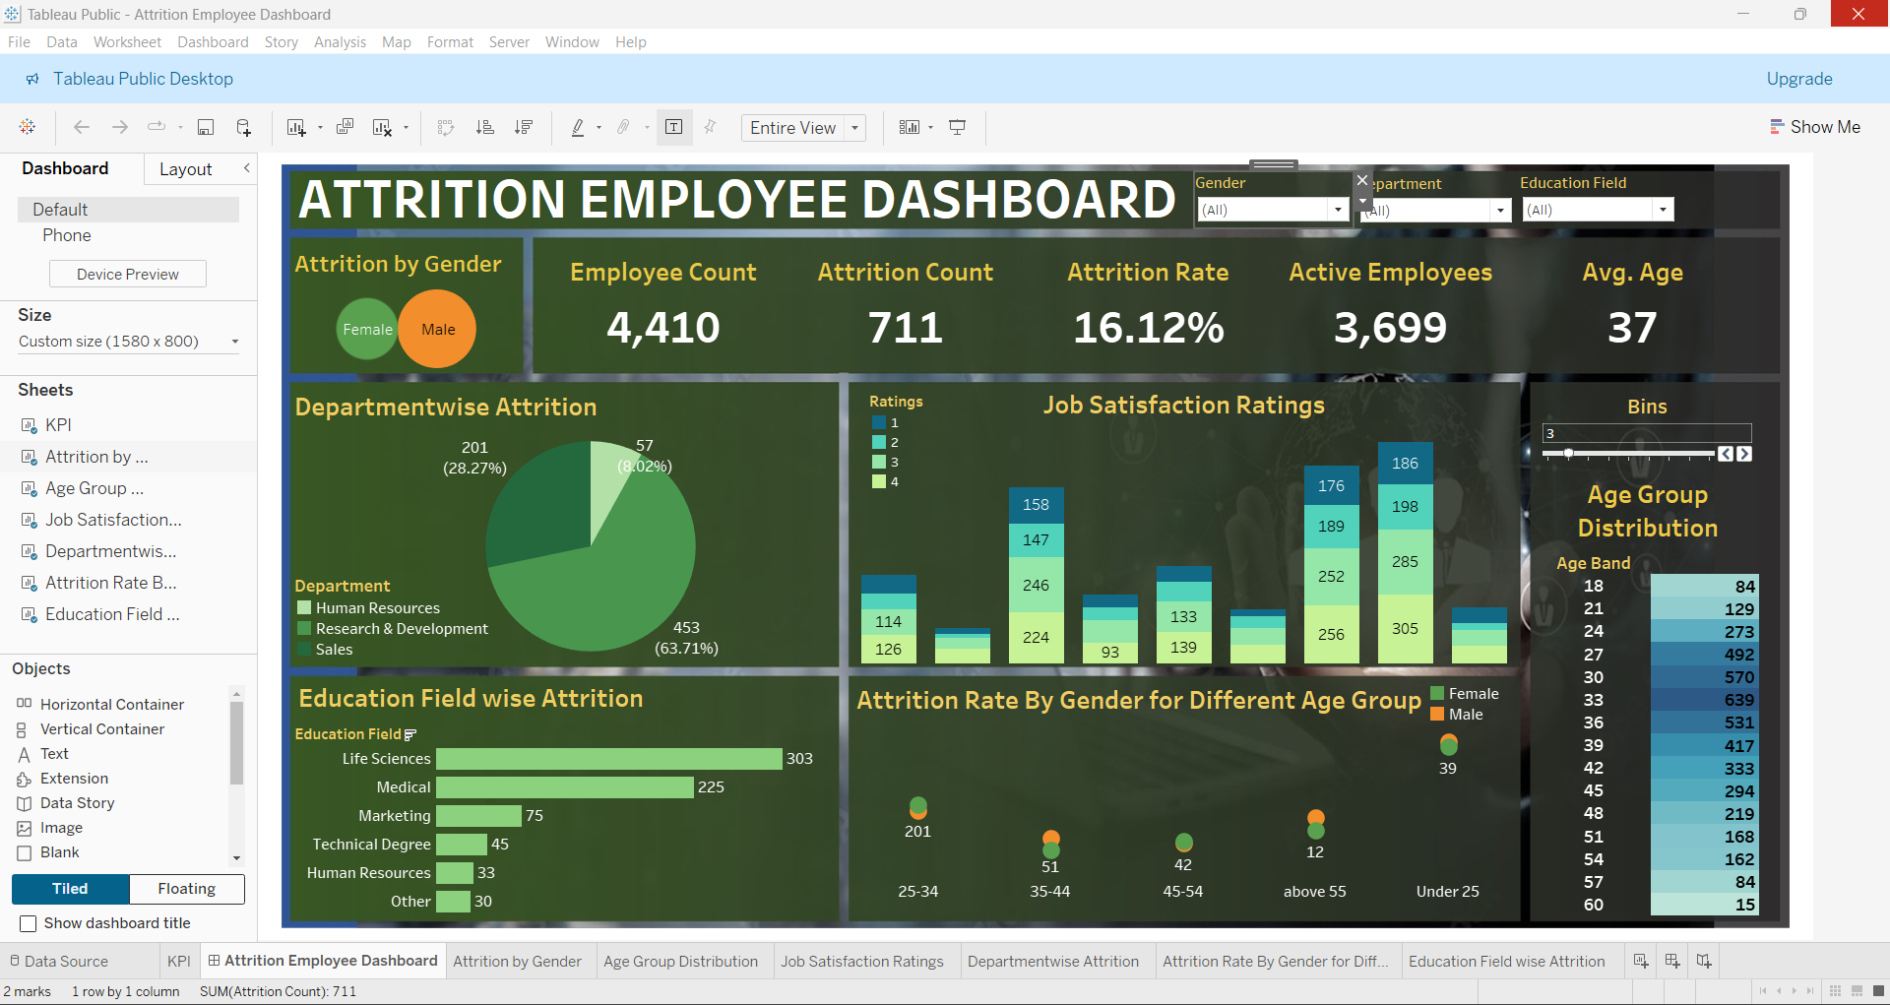
Attrition by Department

Slide 4
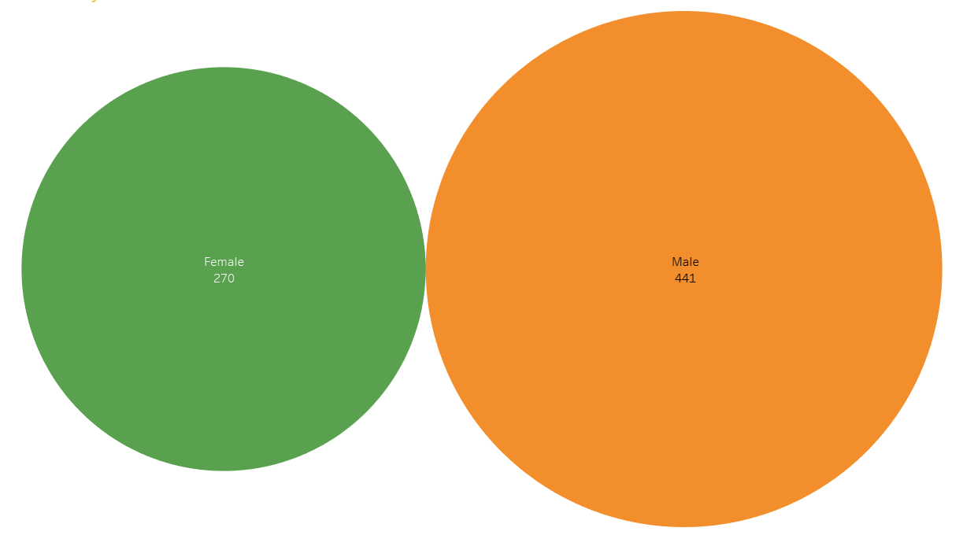
Attrition by Gender

Slide 5
Attrition Rate by Gender for Different Age Groups

Slide 6
Education vs Attrition Rate

Slide 7
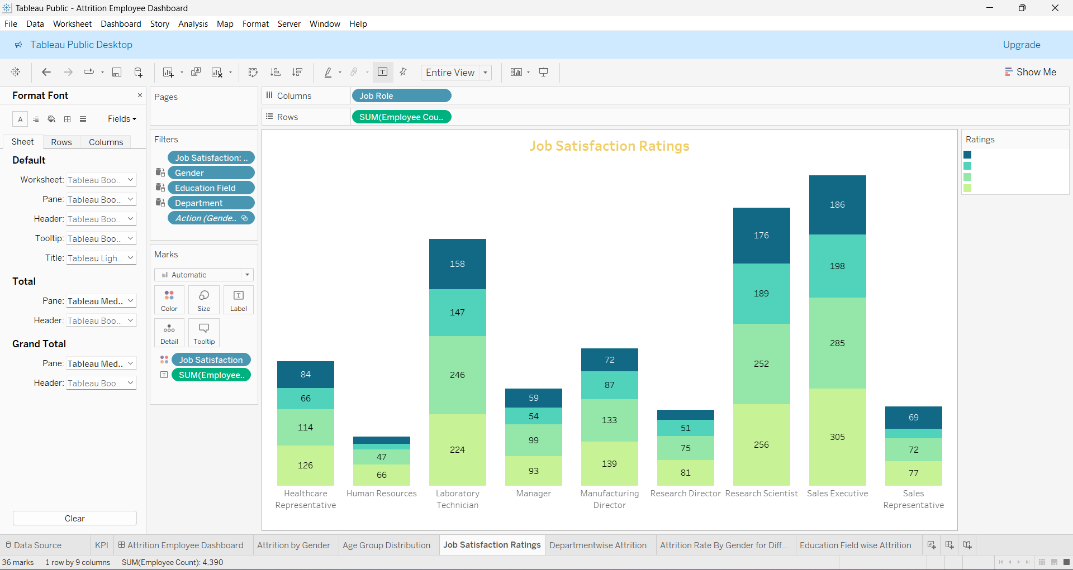
Job Satisfaction Rating

Slide 8
Important KPI’s
EMPLOYEE COUNT – 4,410​
ATTRITION COUNT - 771​
ATTRITION RATE – 16.12%​
ACTIVE EMPLOYEES – 3,699​
AVG. AGE - 37

Slide 9
Employee Attrition Analysis
From Employee Attrition Analysis, the following insights can be ascertained:
Department-wise Research & Development has the highest attrition rate of
63.71% followed by Sales at 28.27% and Human Resources at 8.02%
Male employees have a higher attrition rate than female employees.
Employees having an educational background in Life Sciences, Medical and marketing have a higher attrition rate.
Employees in Human Resources, Sales Representatives and Research Directors have the lowest job satisfaction and hence the highest attrition rate.
Employees with the performance rating of 3 have the highest attrition rate- hence performance rating is positively linked to attrition rate.

Slide 10
Thank You

